Slide 1
Broadcast Receivers
By: Brijesh Patel

Slide 2
Broadcast Receivers simply respond to broadcast messages from other applications or from the system itself. These messages are sometime called events or intents

Slide 3
For example, applications can also initiate broadcasts to let other applications know that some data has been downloaded to the device and is available for them to use, so this is broadcast receiver who will intercept this communication and will initiate appropriate action.

Slide 4
There are following two important steps to make BroadcastReceiver works for the system broadcasted intents −
Creating the Broadcast Receiver.
Registering Broadcast Receiver

Slide 5
Creating the Broadcast Receiver
A broadcast receiver is implemented as a subclass of BroadcastReceiver class and overriding the onReceive() method where each message is received as a Intent object parameter.
public class MyReceiver extends BroadcastReceiver
{
@Override
public void onReceive(Context context, Intent intent)
{
Toast.makeText(context, "Intent Detected.", Toast.LENGTH_LONG).show();
}
}

Slide 6
Registering Broadcast Receiver
An application listens for specific broadcast intents by registering a broadcast receiver in AndroidManifest.xml file.
Consider we are going to register MyReceiver for system generated event ACTION_BOOT_COMPLETED which is fired by the system once the Android system has completed the boot process

Slide 7
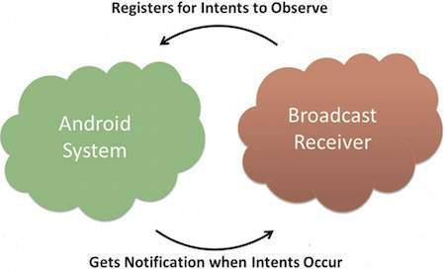
<application
android:icon="@drawable/ic_launcher"
android:label="@string/app_name"
android:theme="@style/AppTheme" >
<receiver android:name="MyReceiver">
<intent-filter>
<action android:name="android.intent.action.BOOT_COMPLETED">
</action>
</intent-filter>
</receiver>
</application>

Slide 8
Sr.No | Event Constant & Description
1 | android.intent.action.BATTERY_CHANGED Sticky broadcast containing the charging state, level, and other information about the battery.
2 | android.intent.action.BATTERY_LOW Indicates low battery condition on the device.
3 | android.intent.action.BATTERY_OKAY Indicates the battery is now okay after being low.
4 | android.intent.action.BOOT_COMPLETED This is broadcast once, after the system has finished booting.
5 | android.intent.action.BUG_REPORT Show activity for reporting a bug.
6 | android.intent.action.CALL Perform a call to someone specified by the data.
7 | android.intent.action.CALL_BUTTON The user pressed the "call" button to go to the dialer or other appropriate UI for placing a call.
8 | android.intent.action.DATE_CHANGED The date has changed.
9 | android.intent.action.REBOOT Have the device reboot.

